Slide 1
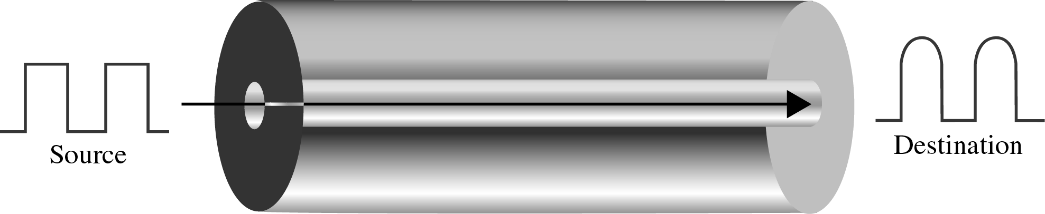
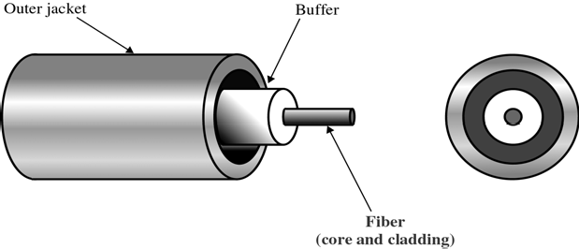
CS601-Data Communication
VU
LECTURE #26
Single Mode Fiber
Uses step index fiber and a highly focused source of light that limits beams to a small range of angles all close to the horizontal
Single Mode fiber is manufactured with a much smaller Diameter than Multimode
All of the beams arrive at the destination together and can be recombined without distortion to the signal
Fiber Sizes
Optical Fibers are defined by the ratio of the diameter of their Core to the diameter of their Cladding
Both the diameters are expressed in Microns (Micrometers)
Fiber type Core Cladding
62.5/125 | 62.5 | 125
50/125 | 50 | 125
100/140 | 100 | 140
8.3/125 | 8.3 | 125
Cable Composition
A core is surrounded by cladding forming the Fiber.
In most cases, fiber is covered by a Buffer layer that protects it from moisture.
Finally the entire cable is encased in an outer jacket
Both core and cladding can be made of either glass or plastic but must be of different densities
In addition the inner core must be ultra pure and completely regular in size and shape
Chemical differences in material and even small variations in the size or shape of the core alter the angle of reflection and distort the signals
130

Slide 2
CS601-Data Communication VU
Some applications can handle a certain amount of distortion and their cables can be made cheaply but others depend on complete uniformity
The outer jacket can be made of several materials including Teflon, Plastic, Fibrous Plastic, metal tubing
Each of these materials have a purpose:
–Plastic is lightweight and cheap but do not provide structural strength and can emit fumes when burnt
–Metal tubing provides strength but is costly
–Teflon is lightweight and can be used in open air but it is expensive and does not increase cable strength
Light Sources for Optical Cable
For tx to occur the sending device must have a light source and the receiving device with a photosensitive cell (Photodiode)
Photodiode converts the light into current usable by the computer
*The light source can either be an LED or an ILD
LED:
–Cheaper but provide Unfocused light that strikes the boundaries of channel at uncontrollable angles
–Limited to short distance use
LASER:
–Can be focused to a narrow range allowing control over angle of incidence
Fiber Optic Connectors
Importance of Connectors
If connector is over tight, two cores can be compressed and angle of reflection of the signal will be altered
All of popular connectors are Barrel shaped that come in male and female versions
The cable has a male connector that fixes into a female connector attached to the device to be connected
Advantages of Optical Fiber
The major advantages of Fiber over twisted pair and coaxial cable are:
*Noise Resistance:
–Because fiber uses light rather than electricity, noise is not a factor
–External light the only form of possible interference is blocked from the channel by the Outer jacket
*Less Signal Attenuation
–Fiber optic Transmission distance is significantly greater than other media
–A signal can run miles w/o regeneration
*Higher Bandwidth
–Can support higher BWs and higher data rates

Slide 3
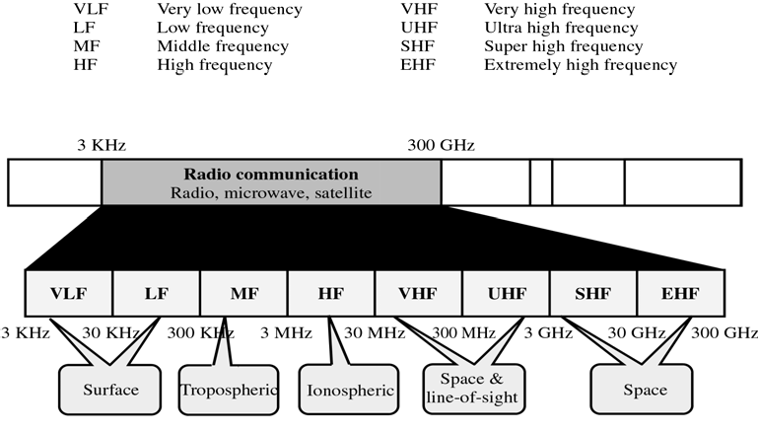
CS601-Data Communication
VU
–High rates are not utilized by absence of signal generation and reception technology
Disadvantages of Optical Fiber
*COST
–Expensive
–No impurities or imperfections can be tolerated, so manufacturing is costly
–Laser light sources can be expensive
*INSTALLATION
–Roughness & Cracking of core cannot be tolerated
–All connections must be perfectly alligned
Disadvantages of Optical Fiber
*Fragility
–Glass fiber is very fragile
–Can not be used in extreme conditions where hardware portability is required
Unguided Media
Unguided Media or Wireless Communication transport Electromagnetic waves without a physical conductor
Instead signals are broadcast through Air and are available to anyone who has a receiver capable of receiving them
Radio Frequency Allocation
The section of EM spectrum defined as Radio Communication is divided into 8 ranges called BANDS
BANDS are rated from very low frequency (VLF) to extremely high frequency (EHF)
Propagation of Radio Waves
Radio Wave transmission utilizes five different types of propagation:

Slide 4
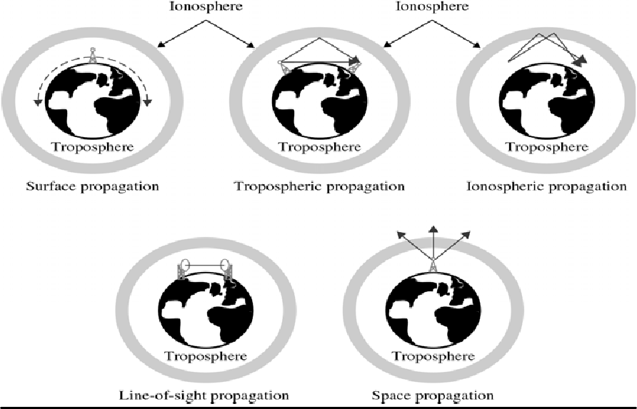
CS601-Data Communication
VU
Types of Propagation:
–Surface
–Tropospheric
–Ionospheric
–Line-of-Sight
–Space
Radio Technology considers the earth as surrounded by two layers of atmosphere:
*TROPOSHERE
It is the portion of the atmosphere extending outwards approx. 30 miles from the earth’s surface
It contains what we call as AIR
Clouds, wind, Temp. variation and weather in general occur in the Troposhere as does jet plane travel
*IONOSPHERE
It is the layer of atmosphere above the troposhere but below space
It is beyond what we think of as atmosphere
*Surface Propagation
In surface propagation, radio waves travel through the lowest layer of the atmosphere, hugging the earth
At the lowest frequencies signal emanate in all direction from the tx antenna and follow the curvature of the planet
Distance depends on the amount of power in the signal
*Troposhpheric Propagation
This can work in two ways:

Slide 5
CS601-Data Communication
VU
Line-of-Sight:
–A signal can be directed in a straight from Antenna to antenna
Broadcast:
–Signal is broadcasted at an angle into the upper layers of the troposphere from where it is reflected back to earth’s surface
The first method demands that both transmitter and receiver be placed within line-of-sight distances and is limited by the curvature of the earth
The second method allows greater distances to be covered
*Ionoshpheric Propagation
Higher frequency radio waves are radiated towards the ionosphere where they are reflected back to the earth
The difference in density between troposhphere and ionosphere causes each radio wave to speed up and change direction bending back to earth
Allows greater distances to be covered by lower power output
*Line of Sight Propagation
Very high frequencies signals are transmitted in straight line from antenna to antenna
Antennas must be directional facing each other or either tall enough or close enough to each other to avoid earth’s curvature
Radio waves can reflect of the objects in the middle and can reach late to the receiver. These late signals distort signal
*Space Propagation
A broadcast signal is received by the orbiting satellites which rebroadcasts the signal to the intended receiver on the earth
Summary
Guided Media
Optical Fiber Cable
Unguided Media
Radio Frequency Allocation
Propagation of Radio Waves
Reading Sections
*Section 7.1,“Data Communications and Networking” 4th Edition by Behrouz A. Forouzan

Slide 6
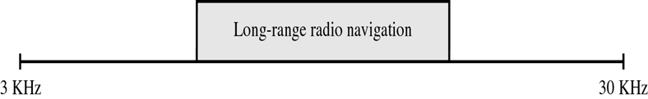
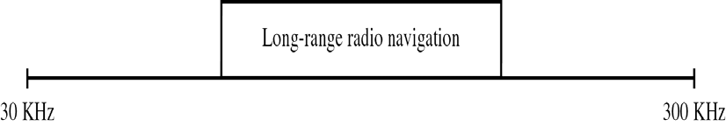
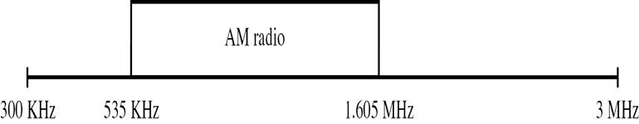
CS601-Data Communication
VU
LECTURE #27
Propagation of Specific Signals
The type of propagation used in radio transmission depends upon the frequency of the signal
Each frequency is suited for a specific layer of atmosphere and is most efficiently transmitted and received by technologies adapted to that layer
Very Low Frequency (VLF) (Figure)
VLF waves are propagated as surface waves through air
Do not suffer much attenuation in TX but are susceptible to high levels of atmospheric noise I.e. electricity and heat
Used for Long-range radio navigation and Submarine Communication
Low Frequency (LF) (Figure)
Also propagated as surface waves
Used for Long-range radio and for navigational locators
Attenuation is greater in the day time when absorption of waves by natural obstacles increases
Middle Frequency (MF)
Propagated in the Troposhere
These frequencies are absorbed by Ionosphere
The distance they cover is limited by the angle needed to get the signal reflect from the troposhere and not enter ionosphere
Absorption increases during the day time
Used for AM Radio
High Frequency (HF) (Figure)
o Use ionospheric propagation

Slide 7
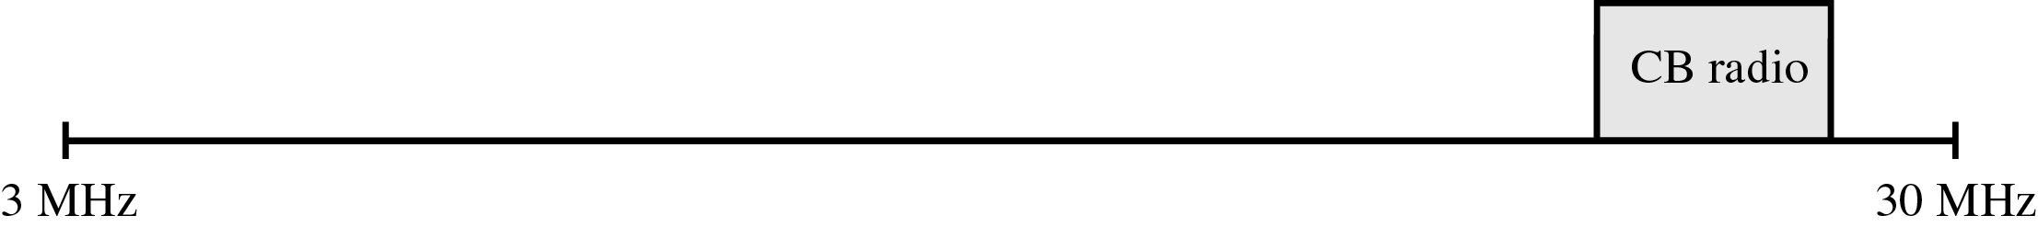
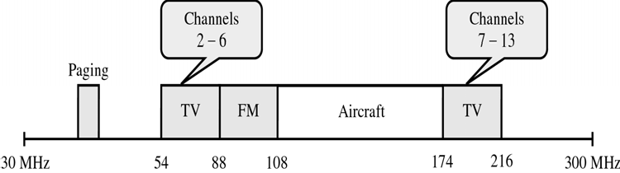
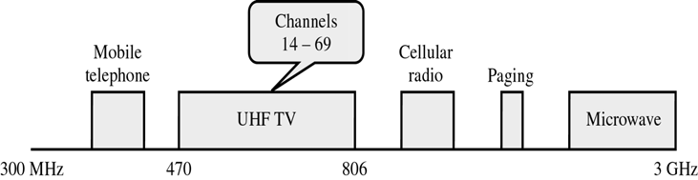
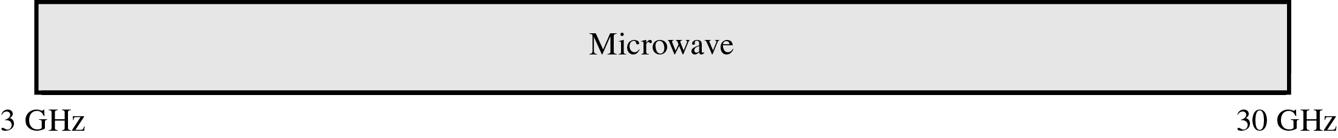
CS601-Data Communication
VU
These frequencies move into the ionosphere where the density difference reflects them back on earth
Used for Citizen’s Band Radio, International Broadcasting, Military Communication, Telephone, Telegraph and Fax
Very High Frequency (VHF) (Figure)
Most VHF waves use line-of-sight propagation
Used for VHF Television, FM Radio, Aircraft AM Radio
o
Ultra High Frequency (UHF) (Figure)
Always use line-of-sight propagation
Used for UHF Television, Mobile Telephone, Cellular Radio, Paging,
Microwave Links
Note that microwave communication begins at 1GHz in UHF and continues into SHF and EHF band
o
Super High Frequency (SHF) (Figure)
SHF waves are TX using mostly line-of-sight and some Space propagation
Used for Terrestrial and Satellite Microwave and Radar Communication

Slide 8

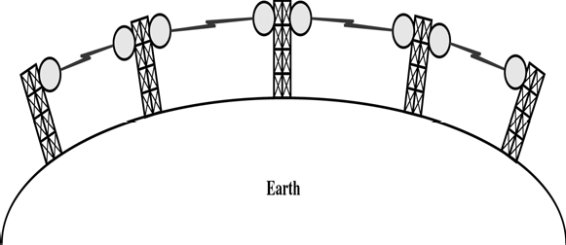
CS601-Data Communication
VU
Extremely High Frequency (EHF) (Figure)
Use space propagation
Used for Radar , Satellite and Experimental Communication
o
Terrestrial Microwave
Microwaves do not follow the curvature of earth and therefore require line-of-sight TX and RX equipment
Distance covered by line-of-sight signal depends to a large extent on the height of the antennas
Height allows the signal to travel farther by crossing a lot of obstacles like low hills and buildings
Microwave signals propagate in one direction at a time, which means that two frequencies are necessary for 2-way communication such as telephone conversation
One frequency is reserved for MICROWAVE communication in one direction and the other for TX in the other direction
Each frequency requires its own transmitter & receiver combined in a Transceiver nowadays
Repeaters
To increase distance for terrestrial microwave, a system of repeaters can be installed with each antenna
A signal received by one antenna can be converted back to the transmittable form and relayed to the next antenna
The distance required b/w repeaters varies with frequencies of the signal and the environment in which the antennas are found
A repeater may broadcast the regenerated signal either at original frequency or a new frequency depending on system
Used in Telephone systems worldwide
Antennas
Two types of Antennas are used for Microwave communication:
–Parabolic Dish

Slide 9
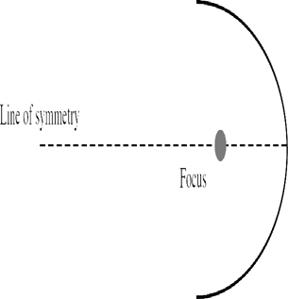
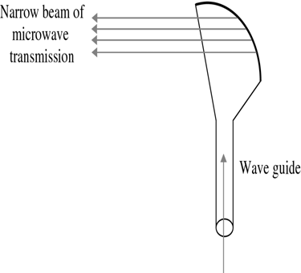
CS601-Data Communication
VU
–Horn
Parabolic Dish
Based on the geometry of a Parabola
Every line parallel to the line of symmetry (line of sight) reflects off the curve at an angle such that they intersect in a common point called FOCUS
Parabolic dish works like a funnel catching a wide range of waves and
directing them to a common point
In his way most of the signal is recovered than would be possible with a single-point receiver
HORN
Outgoing transmissions are broadcast through a horn aimed at the dish. The microwaves hit the dish and and are deflected outward in a reversal of the receipt path
A horn antenna looks like a gigantic scoop
Outward TXs are directed upward a stem and are deflected outward in a series of narrow parallel beams
Satellite Communication
Satellite TX is much like line-of-sight transmission in which one of the stations is the satellite orbiting around the earth
The principle is similar to the terrestrial microwave with a satellite acting as a Super tall antenna and Repeater

Slide 10
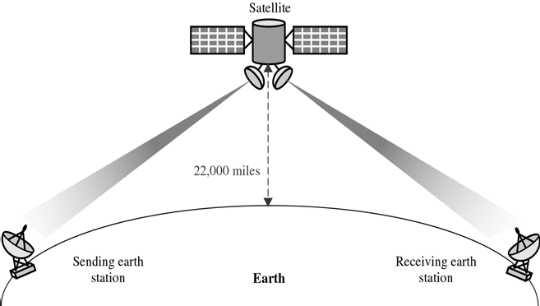
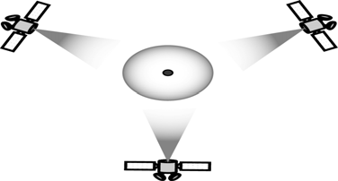
CS601-Data Communication
VU
Although in satellite TX, signals must still travel in straight line, the limitations imposed on distance by curvature of earth are reduced
In this way satellites can span Continents and oceans with one bounce off the satellite
Satellite can provide TX capability to and from any location on earth no matter how remote
This advantage makes high quality communication available to underdeveloped parts of the worked at almost no cost
Satellites themselves are very expensive but leasing a freq or time on one can be cheap
Geosynchronous Satellite
Line of sight propagation requires the sending and receiving antennas must be locked into each other
To ensure continuous communication, satellites must move with the same speed as earth. So that they seem fixes w.r.t earth
These satellites are called Geosynchronous Satellites
Figure shows 3 satellites in geosynchronous orbit each 120 degree from one another so that whole earth can be covered
Satellite Frequency Bands

Slide 11
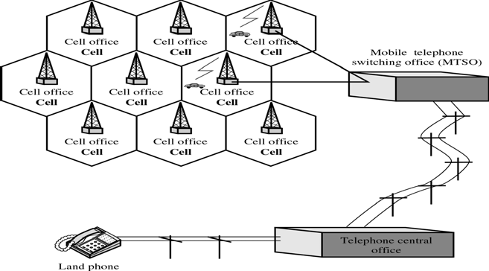
CS601-Data Communication
VU
Each satellite sends and receives over two bands
–Uplink: From the earth to the satellite
–Downlink: From the satellite to the earth
Band Downlink Uplink
C 3.7-4.2 GHz 5.925-6.425 GHz
Ku 11.7-12.2 GH 14-14.5 GHz
Ka 17.7-21 GHz 27.5-31 GHz
Cellular Telephony
Each service area is divided into small ranges called cells
Each cell office is controlled by a switching office called MTSO
Operations of Cellular Telephony
*Transmitting
–Mobile phone sends the number to the closest cell office
–Cell office € MTSO € Telephone office
–MTSO assigns an unused voice channel
*Receiving
–Telephone office sends the signal to MTSO
–MTSO sends queries to each cell (paging)
–If mobile phone is found and available, assigns a channel
*Handoff
–MTSO monitors the signal level every few seconds
140

Slide 12
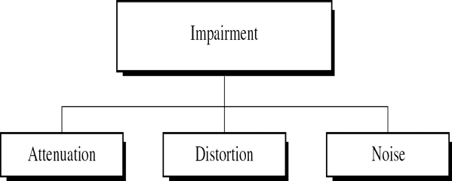
CS601-Data Communication
VU
–If the strength diminishes, MTSO seeks a new cell and changes the channel carrying the call
Transmission Impairments
Transmission media are not perfect What is sent is not what is received
Attenuation
Attenuation means loss of energy
Some of electrical energy is converted to heat
Decibel (dB)
Relative strengths of two signals or a signal at two points dB = 10 log₁₀ (P₂/P₁)
P₂ and P₁ are signal powers
Negative dB means attenuation Positive dB means amplification
Example 7.1
Imagine a signal travels through a transmission medium and its power is reduced to half. This means P₂=(1/2)P₁. Calculate Attenuation?
Solution:
–10log₁₀(P₂/ P₁)= 10log₁₀(0.5 P₁/ P₁)
=10(-0.3)= -3 dB
Distortion
Distortion means that the signal changes its form or shape
Distortion occurs in a composite signal
Summary
Frequency Ranges
Microwave Communication
Satellite Communication
Cellular Telephony
Transmission Impairments
Reading Sections
Section 7.2, 7.3 “Data Communications and Networking” 4th Edition by Behrouz
Forouzan

Slide 13
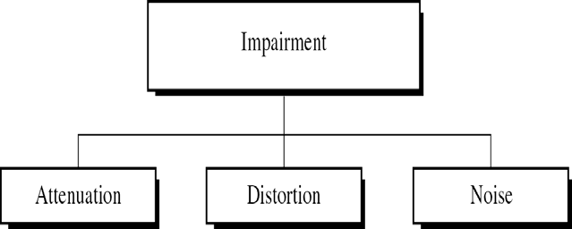
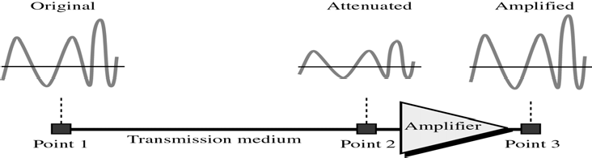
CS601-Data Communication
VU
LECTURE #28
Transmission Impairments
TX Media are not perfect
Imperfections cause impairments in the signal through the medium
This means that the signal at the beginning and the end of the medium are not the same
What is sent is not what is received
Attenuation
Loss of Energy
When a signal travels through a medium, it looses some of its energy in order to overcome the resistance of the medium
That is why wire carrying electric signals get hot
Some of the electrical energy in the signal is converted to heat
To compensate for this loss Amplifiers are used to amplify the signal to heat
Decibel (dB)
Measures the relative strength of the two signals or a signal at 2 different points
dB is negative if a signal is attenuated
dB is positive if a signal is Amplified
Relative strengths of two signals or a signal at two points dB = 10 log₁₀ (P₂/P₁)
P₂ and P₁ are signal powers
Negative dB means attenuation Positive dB means amplification

Slide 14
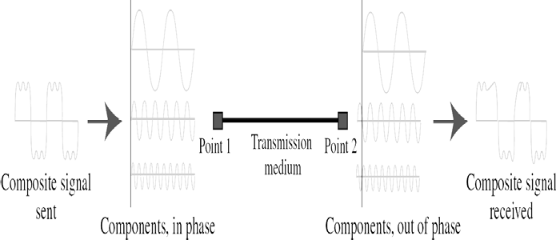
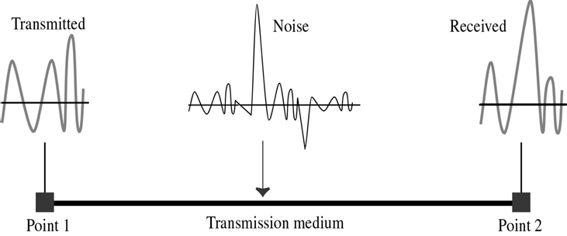
CS601-Data Communication
VU
Example 7.1
Imagine a signal travels through a transmission medium and its power is reduced to half. This means P₂=(1/2)P₁. Calculate Attenuation?
Solution:
–10log₁₀(P₂/ P₁)= 10log₁₀(0.5 P₁/ P₁)
=10(-0.3)= -3 dB
Distortion
Distortion means that the signal changes its form or shape
Distortion occurs in a composite signal
Signal changes its form or shape
Occurs in a composite signal, made of different frequencies
Each signal component has its own speed
NOISE
Thermal Noise
–Due to random motion of electrons in a wire that creates an extra signal not originally sent by TX
Induced Noise
–Comes from sources like Motors and Appliances
Crosstalk:
–Effect of one wire on another
Impulse Noise
–Spike (A signal with high energy in a very short period of time) that comes from power lines, lightening etc,.

Slide 15
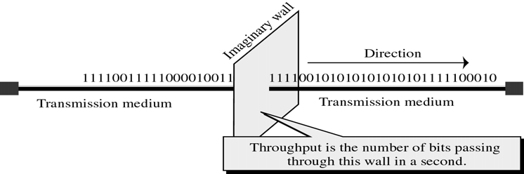
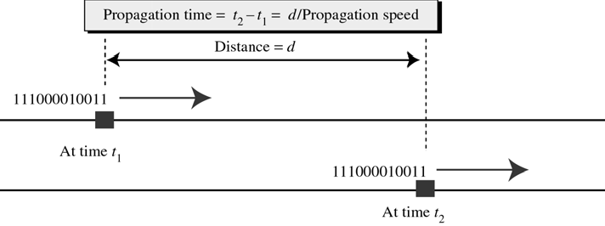
CS601-Data Communication
VU
Performance of Medium
Three concepts are used to measure the performance of TX Media:
–Throughput
–Propagation Speed
–Propagation Time
Throughput
Measurement of how fast data can pass through a point
In other words, if we consider any point in the TX Medium as a wall through which bits pass, then throughput is the number of bits that can pass this wall in second
Propagation Speed
Propagation speed measures the distance a signal or a bit can travel through a medium in one second
The propagation speed of EM signals depend on the medium and the frequency of the signal
Propagation Time
Measures the time required for a signal (or a bit) to travel from one point of the TX medium to another
The propagation time is calculated as:
Propagation time =
Dis tan ce
Pr opagationSpeed
WAVELENGTH
Another characteristic of a signal traveling through the TX Medium
This concept binds the frequency of the signal to the propagation speed of medium
It is customary to talk about wavelength when talking about TX of light in Optical Fiber

Slide 16
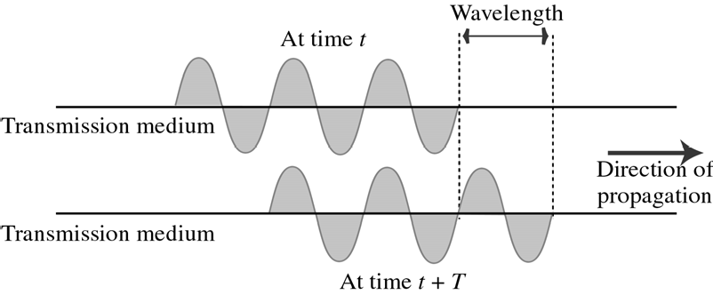
CS601-Data Communication
VU
The wavelength is the distance a simple signal can travel in one period
The wavelength depends on both the frequency and the medium
–Wavelength = Propagation speed * period
–Wavelength = Propagation speed / frequency
Shannon Capacity
In 1944, Claude Shannon introduced a formula to determine the theoretical highest data rate for a channel:
C = B log₂ (1 + S/N) in bps
–B: bandwidth of the channel
–S/N: signal to noise ratio
Examples
Extremely noisy channel
– S/N ≈ 0
– C = B log2 (1+0) = 0
Telephone line
– Bandwidth is 3000 Hz, S/N ratio is 3162 (35 dB)
– C = 3000 log2 (1+3162) = 34,860 bps
Media Comparison
When evaluating the suitability of a particular medium to a specific application, 5 factors should be kept in mind:
*COST: This is the cost of materials plus installation
*SPEED: Speed is the max no. of bits per second that a medium can transmit reliably
–Speed varies with frequency, with physical size of medium and Transmission Equipment
*ATTENUATION: Tendency of EM signal to become weak or distorted over signal
*EM Interference: EMI is the susceptibility of the medium to external EM energy introduced into the link that interferes with the intelligibility of a signal
–Familiar effects of EMI are static(audio) and snow (visual)

Slide 17
CS601-Data Communication
VU
*SECURITY: How easy it is for an unauthorized device to listen on the link?
–Twisted pair is intercept able
–Optical Fiber is more secure
Summary
Transmission Impairments
Performance of Transmission Medium
Wavelength
Shannon Capacity
Media Comparison
Reading Sections
Section 7.4, 7.5, 7.6. 7.7, “Data Communications and Networking” 4th Edition by Behrouz A. Forouzan

Slide 18
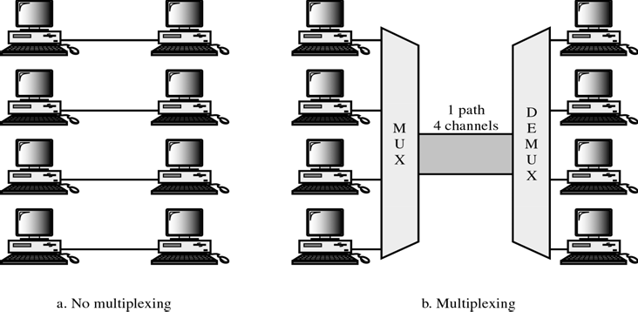
CS601-Data Communication
VU
LECTURE #29
Introduction
Whenever the TX capacity of a medium linking 2 devices is greater than the TX needs of the devices, the link can be shared
Example: Large Water pipe can carry water to several separate houses at once
Multiplexing is the set of techniques that allows simultaneous TX of multiple signals across a single data link
As data communication usage increases, traffic also increases
We can add a new line each time a new channel is needed
Or we can install higher capacity links and use each to carry multiple signals
All current TX media i.e. Coax, Optical fiber have high available BWs
Each of these has carrying capacity far in excess of that needed for one signal
If TX capacity of a link is greater than the TX needs of devices attached to it, the excess capacity is wasted
Multiplexing
Set of techniques that allows the simultaneous transmission of multiple signals across a single data link”
In the multiplexed system, ‘n’ devices share the capacity of one link
Fig. shows two possible ways of linking 4 pairs of device
In fig. (a), each pair has its own link. If full capacity of each link is not utilized, it will be wasted
In fig. (b), TX b/w pairs are multiplexed . The same 4 pairs share the capacity of single link
Fig. (b) shows the basic format of a Multiplexed system
The 4 devices on left direct their TX streams to a MUX , which combines them into a single stream
At the receiving end, that stream is fed into a DEMUX, which separates the stream back into its component transmissions and directs them to their intended devices
*Path: Physical Link
*Channel: A portion of the path that carries TX b/w a given pair of devices
*One path can have many channels

Slide 19
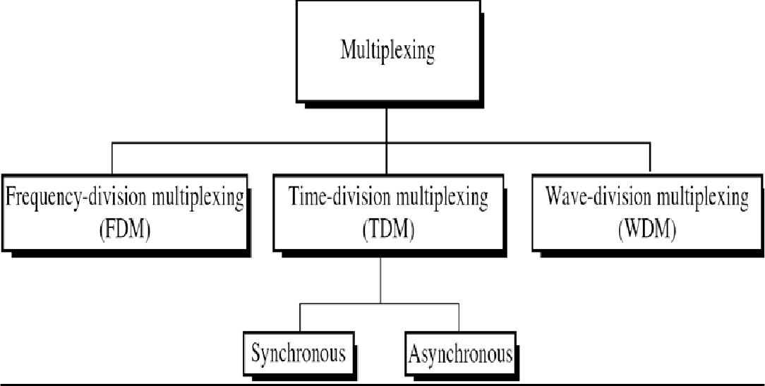
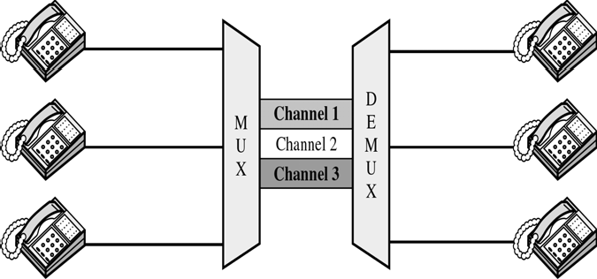
CS601-Data Communication
VU
Categories of Multiplexing
FDM
An analog technique that can be applied when BW of the link is greater than the combined BW of the signals to be TX
Signals generated by each sending device modulate difference carrier frequencies
These modulated signals are then combined into a single Composite signal that can be transported by the link
Carrier frequencies are separated by enough BW to accommodate the modulated signal
These BW ranges are the channels through which the various signals travel
FDM (Guard Bands)
•GUARD BANDS: Channels must be separated by strips of unused BW (guard bands) to prevent signals from Overlapping
In fig. the TX path is divided into 3 parts, each representing a channel to carry one TX
As an analogy, imagine a point where 3 narrow streets merge to form a 3-lane highway

Slide 20
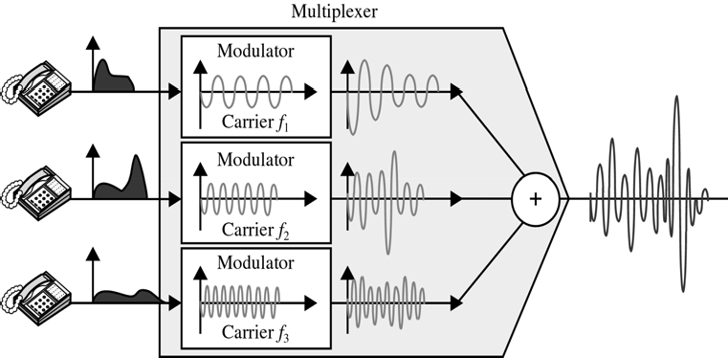
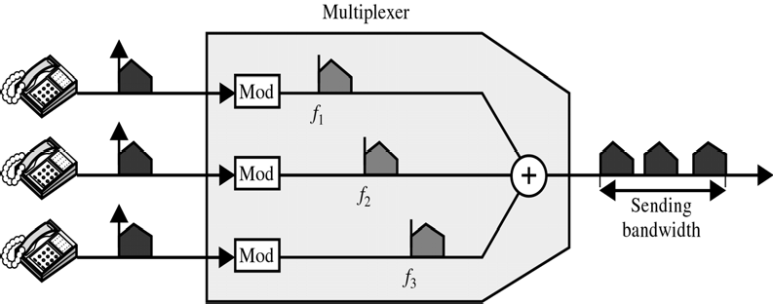
CS601-Data Communication
VU
Each of these streets correspond to a lane of the highway
Each car merging on to the highway from one of these streets still has its own lane and can travel w/o interfering with cars from other lanes
The FDM Process-TIME DOMAIN
Figure shows a Time domain fdm
FDM is an analog process and we show it here in using Telephones as I/p & o/p devices
Each telephone generates a signal of similar frequency range
Inside the MUX, these similar signals are modulated on to different carrier frequencies
The resulting modulated signals are then combined into a single composite signal that is sent over a media link that has enough BW to accommodate it
The FDM Process-Freq domain
Fig is freq domain representation of FDM process
In FDM, signals are modulated onto separate carrier frequencies (f1,f2,f3) using either FM or AM
Modulating one signal into the other results in a BW of at least twice the original

Slide 21
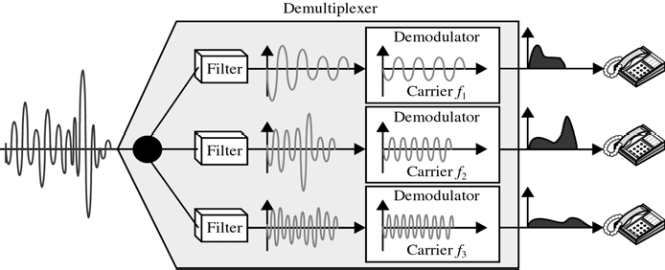
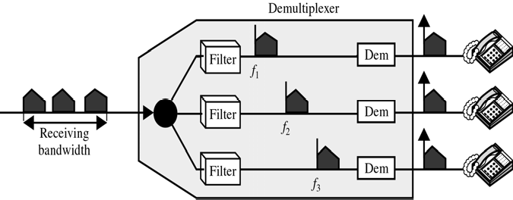
CS601-Data Communication VU
In fig, the BW of resulting composite signal is more than 3 times the BW of each input signal
Plus extra BW to allow for necessary GUARD BANDS
DEMULTIPLEXING
DEMUX uses a series of filters to decompose multiplexed signal into its constituent signals
Individual signals are then passed to a demodulator that separates them to the carriers and passes them to the waiting receivers
DEMULTIPLEXING (Time Domain)
This figure is the time domain representation of the FDM MUX again using 3 telephones as the communication devices
DEMULTIPLEXING (Freq Domain)
This figure is the time domain representation of the FDM MUX again using 3 telephones as the communication devices
Wave Division Multiplexing (WDM)
It is conceptually the same as FDM except that multiplexing and demultiplexing involves light signals TX through fiber optic channels
Idea is the same: We are combining different signals of the different frequencies
However in this case frequencies are very high
150

Slide 22
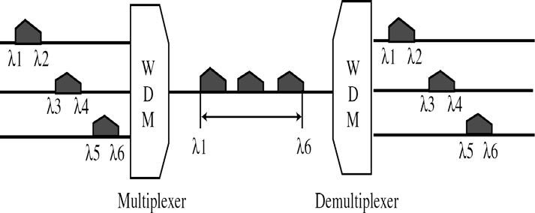
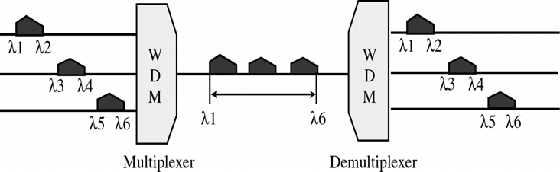
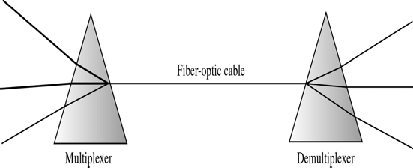
CS601-Data Communication
VU
WDM MUX and DEMUX
Very narrow bands of light from different sources are combined to make a wider band of light
At the receiver are separated by DEMUX
Mechanism of WDM
Although the technology is very complex, the idea is very simple
We want to combine multiple sources into one single light at the the MUX and do the reverse at the DEMUX
PRISM
Combining and Splitting of light sources is easily handled by a PRISM
From Physics, a prism can deflect the light depending upon the angle of incidence and the frequency
o
Using this technique, a MUX can be made to combine several input beams of light
each containing a narrow band of frequencies into one o/p beam of a wider band of frequencies
The DEMUX can also be made to reverse the process
TDM
TDM is a digital process that can be applied when the data rate capacity of the TX medium is greater than the data rate required by the sending and receiving devices

Slide 23
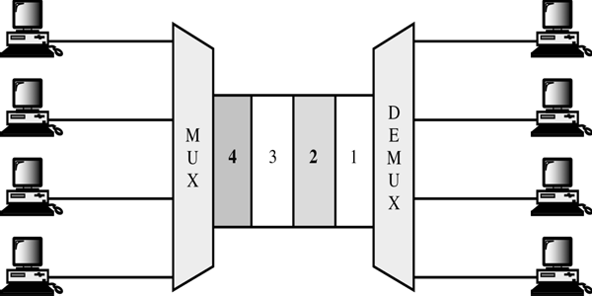
CS601-Data Communication VU
o In such case, multiple transmissions can occupy a single link by subdividing them and Interleaving the portions
In fig, same link is used as in FDM. However, here the link is shown sectioned by time rather than frequency In TDM fig, portions of signals 1, 2, 3 and 4 occupy the link sequentially
Implementation of TDM
TDM can be implemented in two ways:
–Synchronous TDM
–Asynchronous TDM
Synchronous TDM
The term synchronous has a different from that used in other areas of telecommunication
Here synchronous means that MUX allocates exactly the same time slot to each device at all device whether or not the device has any thing to transmit
Synchronous TDM Example
Time slot A for example is assigned to device A alone and cannot be used by any other device
Each time its allocated time slot comes up a device has the opportunity to send a portion of its data
If a device is unable to transmit or does not have data to send time slot remains empty
Synchronous TDM Frames
Time slots are grouped into Frames
A frame consists of one complete cycle of Time slots including one or more slots dedicated to each sending device
In a system with ‘n’ I/p lines, each frame has atleast ‘n’ slots with each slot allocated to carrying data from a specific I/p line
If all the I/p devices sharing a link are transmitting at the same data rate, each device has 1 timeslot per frame
However it is possible to accommodate varying data rates
A TX with two slots per frame will arrive twice as quickly as one with 1 slot per frame

Slide 24
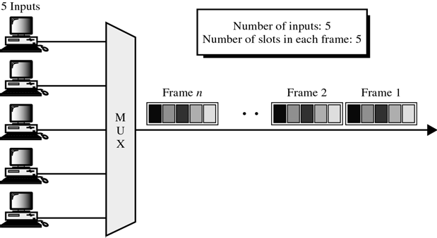
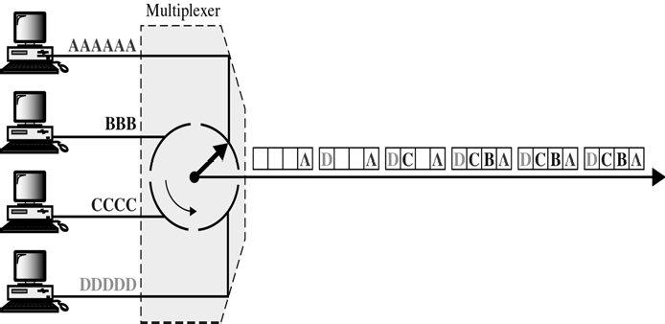
CS601-Data Communication
VU
o The time slots dedicated to a given device occupy the same location in each frame and constitute that device’s channel
In figure, we have 5 I/p lines Multiplexed onto a single path using synchronous TDM
In this example all of the I/p’s have the same data rate, so the number of time slots in each frame is equal to the number of I/p lines
Interleaving
Synchronous TDM can be compared to a very fast rotating switch
As the switch opens in front of a device, the device has the opportunity to send a specifies amount of data on to the path
The switch moves from device to device at a constant rate and in a fixed order
This process is called INTERLEAVING
Interleaving can be done by BITS, BYTES or by any other DATA UNIT
In other words MUX can take one byte from each device, then another byte from each device and so on
In a given system interleaved units will always be of the same size
Fig,, shows interleaving and frame building
In the example we interleave the various TXs by character (equal to 1 byte each) but the concept is the same for data units of any length
Each device is sending a different message
The MUX interleaves the different and forms them into FRAMES before putting them onto the link
At the receiver the DEMUX decomposes each frame by extracting each character

Slide 25
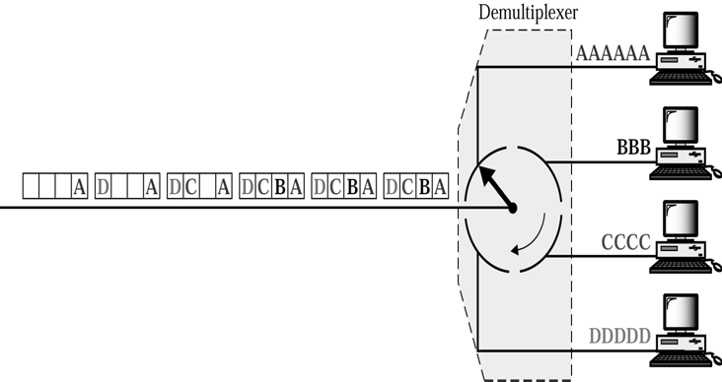
CS601-Data Communication VU
As a character is removed from a frame, it is passed to the appropriate receiving device
Weakness of Synchronous TDM Figure
Both figures point out major weakness in Synchronous TDM
By assigning each timeslot to a specific I/p line, we end up with empty slots whenever not all the lines are active
In figure only the first three frames are completely filled, The last 3 frames have a collective 6 empty slots
Having 6 empty slots out of 24 means that a quarter of a capacity of the link is wasted
Framing Bits
Because the time slots order in a synchronous TDM does not vary from frame to frame, very little overhead information need to be included in each frame
The order of receipt tells the DEMUX where to direct each time slot so no ADDRESSING is necessary
Demultiplexing Process
Demultiplexer decomposes each frame by extracting each data unit in turn
Weakness of synchronous TDM
–Waste of empty slots
Framing Bits
Various factor however can cause timing inconsistencies.
For this reason one or more synchronization bits are added to the beginning of each frame
These bits called Framing bits follow a pattern frame to frame that allows a DEMUX to synchronize with the incoming stream so that it can separate time slots accurately
This synch info consist of one bit /frame alternating b/w 0 and 1.

Slide 26
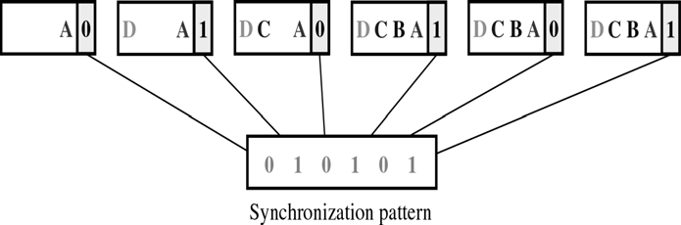
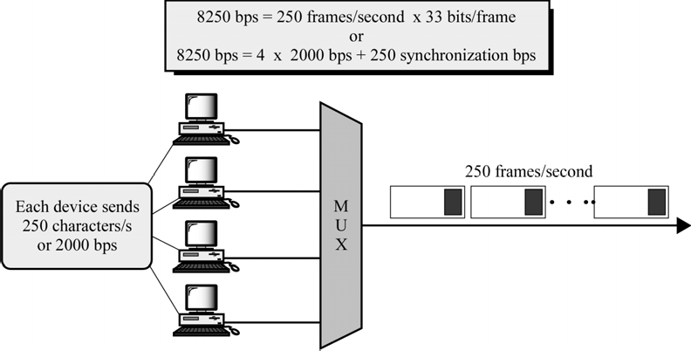
CS601-Data Communication
VU
Synchronous TDM Example
Summary
Multiplexing
Frequency division multiplexing
Wave division multiplexing
Time division multiplexing
Reading Sections
* Section 8.1,8.2,8.3,8.4
“Data Communications and Networking” 4th Edition by Behrouz A. Forouzan

Slide 27
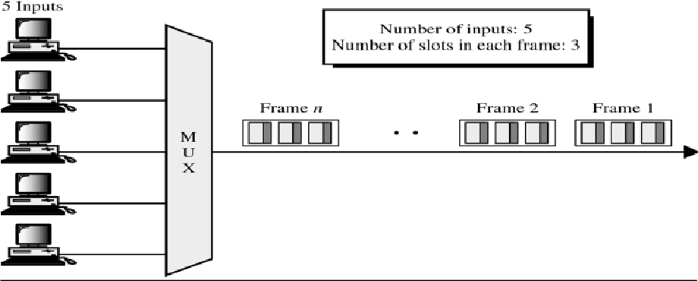
CS601-Data Communication
VU
LECTURE #30
Bit Stuffing
It is possible to connect devices of different data rates to synchronous TDM
For Example, device A uses one time slot, while the faster device B uses two slots
The Time slot length is FIXED
Therefore data rates should be integer multiples of each other
For example, we can accommodate a device that is 5 times faster than the other device by giving it five slots to one for each of the other devices
We cannot accommodate a device which is five and a half times faster using this method because we cannot introduce half a time slot into a frame
When the speeds are not integer multiples of each other, they can be made to behave as if they were
This is done by a technique known as BIT STUFFING
In bit stuffing, MUX adds extra bits to a device
For Example, if we have one device with a bit rate of 2.75 times that of other devices, we can add enough bits to raise this rate to 3 times that of others
The extra bits are then discarded by the Demultiplexer
Asynchronous TDM
Synchronous TDM does not guarantee full utilization of the timeslots
Because the time slots are fixed and pre assigned, whenever a connected device is not transmitting, the corresponding slot is empty and much of the channel capacity is wasted
For Example, imagine that we have multiplexed the o/p of 20 identical computers onto a single line
Using synchronous TDM, the speed of that line must be at least 20 times the speed of each i/p line
But what if only 10 computers are in use at a time?
Half of the capacity of the line is wasted
Asynchronous TDM or Statistical TDM is designed to avoid this type of waste
Asynchronous means flexible or Not fixed
In an asynchronous system, if we have ‘n’ input lines, the frame contains no more than ‘m’ slots, where m is less than n
In this way asynchronous TDM supports the same number of I/p lines as synchronous TDM with a lower capacity link
A slot is available to any device that wants to send data
MUX scans I/p lines, accepts data until a frame is filled and then sends the frame across the link

Slide 28
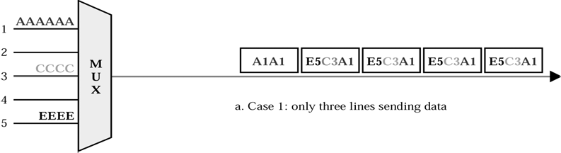
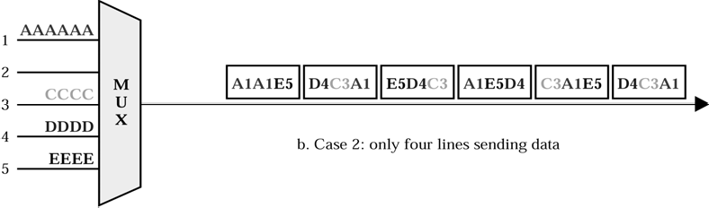
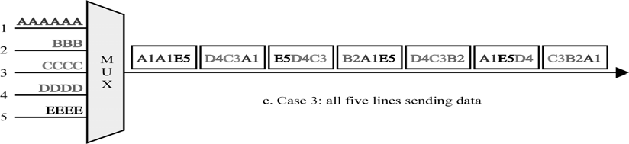
CS601-Data Communication
VU
Advantages of Asynchronous TDM
*Two major advantages:
–Ability to allocate time slots dynamically
–Lower ration of time slots to I/p lines
Above two factors greatly reduce the likelihood of a waste
Fig. shows a system with 5 I/p lines sharing a link using Asynchronous TDM
Frame size is 3 slots per frame
Fig shows how MUX handles 3 levels of traffic
In the first case, only 3 of the 5 computers have data to send
In the second case, 4 lines are sending data
In the third case, all devices are sending data
In each case, MUX scans the devices in order from 1 to 5 filling time slots as it encounters data to be sent
Asynchronous TDM Figure 1
In the first case, the 3 active i/p lines correspond to the 3 slots in each frame
For the first 4 frames, the I/p is symmetrically distributed among all the devices.
By the 5th frame however, devices 3 and 5 have completed their transmission but device 1 still has two characters to go
Asynchronous TDM Figure 2

Slide 29
CS601-Data Communication VU
The MUX picks up the A from device 1, scans down the line without finding another transmission and returns to device 1 to pick up the last A
There being no data to fill the final slot, the MUX then fills the 5th frame with only 2 slots filled
Compare with Synchronous TX: 6 frames of 5 slots each would be required=30 slots, 14 slots used only
In second case, there is one more I/p line than there are slots in each frame
This time MUX scans from 1 to 5 and fills up a frame before each of the lines are checked
The first frame contains data from device 1, 3,and 4
Asynchronous TDM Figure 3
MUX continues the scan and puts first portion of 5th device into the first slot of next frame and so on
When the number of active senders does not equal the number of slots in a frame, the time slots are not filled symmetrically
Device 1 occupies the first slot in the first frame , 2nd slot in second frame and so on
In the third case, frames are filled as shown above
All 5 I/p lines are active
In this case device 1 occupies the 1st slot in the first frame, the 3rd slot in the second frame and so on
Aspects of Asynchronous TDM
Addressing and Overhead
Case 2 & 3 above show a major weakness of Asynchronous TDM
How does the DEMUX know which slot belongs to which output line?
As opposed to Synchronous TDM, in this case, data from a given device might be in the first slot of one frame and in the third of the next
Therefore, each time slot must carry an address telling the DEMUX how to direct data
This address is for local use only attached by the MUX and detached by the DEMUX
In the figure above address is specified by a digit
Adding address bits to each time slot increase the overhead of an Asynchronous system and limits its efficiency
Addresses usually consist of only a small number of bits
Need for Addressing makes Asynchronous TDM inefficient for bit or byte interleaving
Imagine bit interleaving with each bit carrying an address
One bit of data plus 3 bits of address
Asynchronous TDM is efficient only when the size of the time slot is kept relatively large
Inverse Multiplexing
Opposite of Multiplexing
Takes data from one high speed line and breaks it into portions that can be sent over several lower speed lines simultaneously
Why do we need Inverse Multiplexing?
An organization wants to send data, voice and video each of which requires a different data rate
To send voice it needs 64Kbps,
To send data, it needs 128 Kbps link

Slide 30
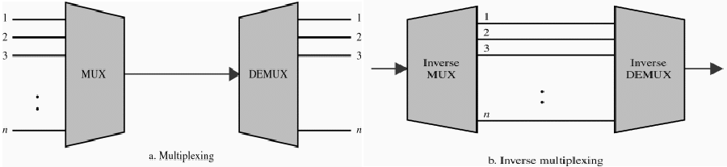
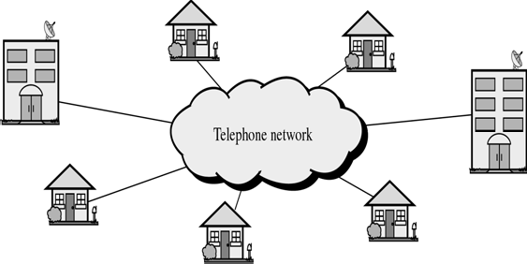
CS601-Data Communication
VU
To send video it may need 1.544 Mbps link
It can lease a 1.544 Mbps line from a common carrier and only use it fully for sometime
Or it can lease several separate channels of lower data rates
Voice can be sent over any of these channels
Data & Video can be broken into smaller portions using Inverse Multiplexing and TX
Multiplexing Application
THE TELEPHONE SYSTEM
Multiplexing has long been used as an essential tool in the Telephone industry
A country’s telephone system may include various carriers that offer local and long-distance service
These various carriers form a Telephone Network I.e. PTCL
*Each subscriber is connected to the telephone network as a service line
Summary
Time Division Multiplexing
Asynchronous TDM
Inverse Multiplexing
The Telephone System
Reading Sections
Section 8.4,8.5 “Data Communications and Networking” 4th Edition by Behrouz
Forouzan

